Slide 1
Introduction to Hive
.

Slide 2
Outline
Motivation
Overview
Data Model
Working with Hive
DDL Operations
Custom mapper scripts
User Defined Functions
Wrap up & Conclusions

Slide 3
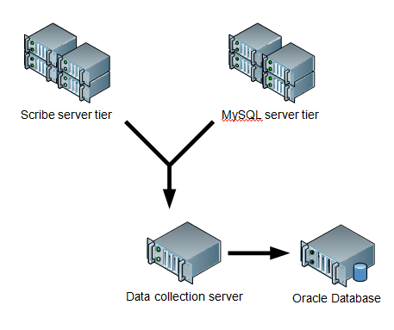
Background
Started at Facebook
Data was collected by nightly cron jobs into Oracle DB
“ETL” via hand- coded python
Grew from 10s of GBs (2006) to 1 TB/day new data (2007),now 10x that.

Slide 4
Hive Applications
Log processing
Text mining
Document indexing
Customer-facing business intelligence (e.g., Google Analytics)
Predictive modeling, hypothesis testing

Slide 5
Hive Components
Shell: allows interactive queries like MySQL shell connected to database
- Also supports web and JDBC clients
Driver: session handles,fetch,execute
Compiler:parse,plan,optimize
Execution engine: DAG of stages (M/R, HDFS, or metadata)
Metastore: schema, location in HDFS,SerDe

Slide 6
Data Model
Tables
– Typed columns (int, float, string, boolean)
– Also, list: map (for JSON-like data)
Partitions
– e.g., to range-partition tables by date
Buckets
– Hash partitions within ranges (useful for sampling, join optimization)

Slide 7
Metastore
Database: namespace containing a set of tables
Holds table definitions (column types, physical layout)
Partition data
Uses JPOX ORM for implementation; can be stored in Derby, MySQL, many other relational databases

Slide 8
Physical Layout
Warehouse directory in HDFS
– e.g., /user/hive/warehouse
Tables stored in subdirectories of warehouse
– Partitions form subdirectories of tables
Actual data stored in flat files
– Control char-delimited text, or SequenceFiles
– With custom SerDe, can use arbitrary format

Slide 9
Starting the Hive shell
Start a terminal and run
$hive
Should see a prompt like:
hive>

Slide 10
Creating tables
hive> SHOW TABLES;
hive> CREATE TABLE shakespeare (freq INT, word STRING) ROW FORMAT DELIMITED FIELDS TERMINATED BY „\t‟ STORED AS TEXTFILE;
hive> DESCRIBE shakespeare;

Slide 11
Generating Data
Let’s get (word, frequency) data from the Shakespeare data set:
$hadoop jar \$HADOOP_HOME/hadoop-*-examples.jar \grep input shakespeare_freq „\w+‟

Slide 12
Loading data
Remove the MapReduce job logs:
$hadoop fs -rmr shakespeare_freq/_logs
Load dataset into Hive:
hive> LOAD DATA INPATH “shakespeare_freq” INTO TABLE shakespeare;

Slide 13
Selecting data
hive> SELECT * FROM shakespeare LIMIT 10;
hive> SELECT * FROM shakespeare WHERE freq > 100 SORT BY freq ASC LIMIT 10;

Slide 14
Most common frequency
hive> SELECT freq, COUNT(1) AS f2 FROM shakespeare GROUP BY freq SORT BY f2 DESC LIMIT 10;
hive> EXPLAIN SELECT freq, COUNT(1) AS f2 FROM shakespeare GROUP BY freq SORT BY f2 DESC LIMIT 10;

Slide 15
Joining tables
A powerful feature of Hive is the ability to create queries that join tables together
We have (freq, word) data for Shakespeare
Can also calculate it for KJV
Let’s see what words show up a lot in both

Slide 16
Create the dataset
$cd ~/git/data
$tar zxf bible.tar.gz
$hadoop fs –put bible bible
$hadoop jar \$HADOOP_HOME/hadoop-*-examples.jar \grep bible bible_freq „\w+‟

Slide 17
Create the new table
hive> CREATE TABLE kjv (freq INT, word STRING) ROW FORMAT DELIMITED FIELDS TERMINATED BY „\t‟ STORED AS TEXTFILE;
hive> SHOW TABLES;
hive> DESCRIBE kjv;

Slide 18
Import data to Hive
$ hadoop fs –rmr bible_freq/_logs
hive> LOAD DATA INPATH “bible_freq” INTO TABLE kjv;

Slide 19
Create an intermediate table
hive> CREATE TABLE merged (word STRING, shake_f INT, kjv_f INT);

Slide 20
Running the join
hive> INSERT OVERWRITE TABLE merged SELECT s.word, s.freq, k.freq FROM shakespeare s JOIN kjv k ON (s.word = k.word)
WHERE s.freq >= 1 AND k.freq >= 1;
hive> SELECT * FROM merged LIMIT 20;

Slide 21
Most common intersections
What words appeared most frequently in both corpuses?
hive> SELECT word, shake_f, kjv_f, (shake_f +kjv_f) AS ss
FROM merged SORT BY ss LIMIT 20;

Slide 22
Manipulating Tables
DDL operations
SHOW TABLES
CREATE TABLE
ALTER TABLE
DROP TABLE
Loading data
Partitioning and bucketing

Slide 23
Creating Tables in Hive
Most straightforward:
CREATE TABLE foo(id INT,msg STRING);
Assumes default table layout
-Text files; fields terminated with ^A, lines terminated with \n

Slide 24
Changing Row Format
Arbitrary field,record separators are possible. e.g., CSV format:
CREATE TABLE foo(id INT, msg STRING)
ROW FORMAT
DELIMITED FIELDS TERMINATED BY “,” LINES TERMINATED BY “\n”;
Does not support “OPTIONALLY ENCLOSED BY” escape syntax

Slide 25
MapReduce Text Output
CREATE TABLE foo(id INT, msg STRING) ROW FORMAT
DELIMITED FIELDS TERMINATED BY „\t‟ LINES TERMINATED BY „\n‟;

Slide 26
SequenceFile Storage
CREATE TABLE foo(id INT, msg STRING) STORED AS SEQUENCEFILE;
Can also explicitly say “STORED AS TEXTFILE”

Slide 27
Data Types
Primitive types:
– TINYINT
– INT
– BIGINT
– BOOLEAN
– DOUBLE
– STRING
Type constructors:
– ARRAY < primitive-type >
– MAP < primitive-type, primitive-type >

Slide 28
Loading Data
HDFS-resident data:
LOAD DATA INPATH „mydata‟ [OVERWRITE] INTO TABLE foo;
Local filesystem data:
LOAD DATA LOCAL INPATH “mydata” INTO TABLE foo;

Slide 29
Subquery
Subquery syntax
SELECT ... FROM (subquery) name ...
Hive supports sub queries only in the FROM clause. The subquery has to be given a name because every table in a FROM clause must have a name.
Columns in the subquery select list must have unique names. The columns in the subquery select list are available in the outer query just like columns of a table.
The subquery can also be a query expression with UNION. Hive supports arbitrary levels of sub-queries.

Slide 30
Subquery Example
Example with simple subquery:
SELECT col FROM
( SELECT a+b AS col FROM t1 ) t2
Example with subquery containing a UNION ALL:
SELECT t3.col FROM
( SELECT a+b AS col FROM t1 UNION ALL SELECT c+d AS col FROM t2 ) t3

Slide 31
Aggregations
In order to count the number of distinct users by gender one could write the following query:
SELECT pv_users.gender, count (DISTINCT pv_users.userid) FROM pv_users GROUP BY pv_users.gender;
Multiple aggregations can be done at the same time, however, no two aggregations can have different DISTINCT columns
SELECT pv_users.gender, count(DISTINCT pv_users.userid), count(*), sum(DISTINCT pv_users.userid) FROM pv_users GROUP BY pv_users.gender;
However, the following query is not allowed
SELECT pv_users.gender, count(DISTINCT pv_users.userid), count(DISTINCT pv_users.ip) FROM pv_users GROUP BY pv_users.gender;

Slide 32
Partitioning Data
One or more partition columns may be specified:
CREATE TABLE foo (id INT, msg STRING) PARTITIONED BY (dt STRING);
Creates a subdirectory for each value of the partition column, e.g.:
/user/hive/warehouse/foo/dt=2009-03-20/
Queries with partition columns in WHERE clause can scan through only a subset of the data

Slide 33
Loading Data Into Partitions
LOAD DATA INPATH „new_logs‟ INTO TABLE mytable PARTITION(dt=2009-03-20);

Slide 34
Sampling Data
May want to run query against fraction of available data
SELECT avg(cost) FROM purchases TABLESAMPLE (BUCKET 5 OUT OF 32 ON rand());
Randomly distributes data into 32 buckets and picks data that
falls into bucket #5

Slide 35
Bucketing Data In Advance
TABLESAMPLE on rand() or non-bucket column causes full data scan
Better: pre-bucket the data for sampling queries, and only scan pre-designed buckets
CREATE TABLE purchases(id INT,cost DOUBLE, msg STRING) CLUSTERED BY id INTO 32 BUCKETS;
Important: must remember to set mapred.reduce.tasks = 32 for ETL operations on this table.

Slide 36
Loading Data Into Buckets
Bucketed tables require indirect load process
– LOAD DATA INPATH… just moves files
Example Table:
CREATE TABLE purchases(id INT, cost DOUBLE, msg STRING) CLUSTERED BY id INTO 32 BUCKETS;

Slide 37
Populate the Loading Table
CREATE TABLE purchaseload(id INT, cost DOUBLE, msg STRING);
LOAD DATA INPATH “somepath” INTO TABLE purchaseload;

Slide 38
SELECT Into the Real Table
set mapred.reduce.tasks = 32
# this must ==number of buckets!
FROM (FROM purchaseload SELECT id, cost, msg CLUSTER BY id) pl
INSERT OVERWRITE TABLE purchases
SELECT *;

Slide 39
Using Custom Mappers and Reducers
Hive has integration with Hadoop Streaming
– Use streaming scripts; tab-delimited string I/O
– MAP
– REDUCE
– TRANSFORM
Operators all take scripts as arguments

Slide 40
Preloading Mapper Scripts
script-cmd can be an arbitrary command
– e.g., /bin/cat
If you have a custom mapper script, need to pre-load files to all nodes:
ADD FILE mymapper.py

Slide 41
Streaming example
FROM (
FROM pv_users
MAP pv_users.userid, pv_users.date
USING 'map_script' AS dt,uid CLUSTER BY dt) map_output
INSERT OVERWRITE TABLE pv_users_reduced REDUCE map_output.dt, map_output.uid USING 'reduce_script'
AS date, count;

Slide 42
Transform Example
INSERT OVERWRITE TABLE u_data_new
SELECT
TRANSFORM (userid, movieid, rating, unixtime)
USING 'python weekday_mapper.py' AS (userid, movieid, rating,weekday)
FROM u_data;

Slide 43
Dropping Data
DROP TABLE foo
-- delete a table
ALTER TABLE foo DROP PARTITION(col=value)

Slide 44
Extending Tables
ALTER TABLE table_name ADD COLUMNS (col_name data_type [col_comment],
...)
Can add non-partition columns to table

Slide 45
Resorting Tables
Changing partitions, buckets for table requires full rescan
Create a new table to hold the new layout
Then for each partition:
INSERT OVERWRITE new-table-name PARTITION (col=value) SELECT * FROM old-table WHERE col=value CLUSTER BY cluster-col;

Slide 46
Hive User-defined function (UDF)
Sometimes the query you want to write can’t be expressed easily (or not at all) using the built-in functions that Hive provides. By writing user defined function ( UDF),Hive makes it easy to plug in your own processing code and invokes it from hive query.
UDFs have to be written in java. For other languages, you have to use SELECT TRANSFORM query, which allows you to stream data through a user-defined script.

Slide 47
Types Of UDF
There are three types of UDFs in Hive: regular UDF, UDAF and UDTF.
A UDF operates on single row and produces a single row as its output. Most functions, such as mathematical functions and string functions are of this type.
A UDAF works on multiple input rows and creates a single output row. Aggregate functions include such as COUNT and MAX.
A UDTF operates on a single row and produces multiple rows – a table – as output.

Slide 48
User-defined function (UDF)
New UDF classes need to inherit from org.apache.hadoop.hive.ql.exec.UDF class. All UDF classes are required to implement one or more methods named "evaluate" which will be called by Hive. The following are some examples:
public int evaluate ();
public int evaluate (int a);
public double evaluate (int a, double b);
public String evaluate (String a, int b, String c);
"evaluate" should never be a void method. However it can return "null" if needed.
The evaluate() method is not defined by an interface since it may take an arbitrary number of arguments, of arbitrary types, and it may return a value of arbitrary type. Hive introspects the UDF to find the evaluate() method that matches the Hive function that was invoked.

Slide 49
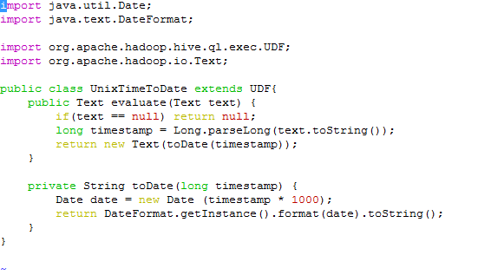
User-defined function (UDF) example

Slide 50
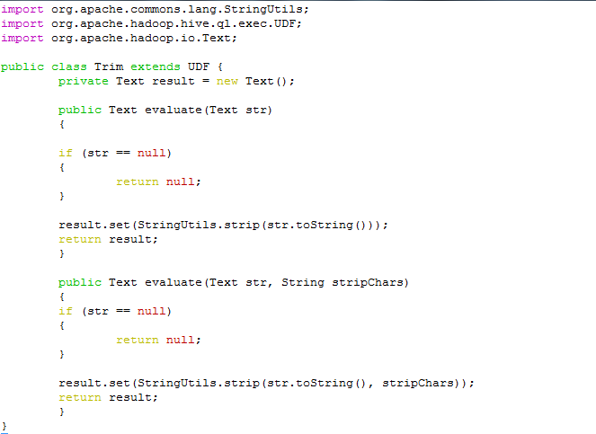
User-defined function (UDF) example
Notes:
The Trim class has two evaluate() methods. The first trims leading and trailing whitespace
from the input, while the second can trim any of a set of supplied characters from
the ends of the string.

Slide 51
User-defined function (UDF)
Hive supports Java primitives in UDFs (and a few other types like java.util.List and java.util.Map), so a signature
like: public String evaluate(String str) would work equally well. However, by using Text, we can take advantage of object reuse, which can bring efficiency savings, and so is to be preferred in general.

Slide 52

User-defined function (UDF)
To use the UDF in Hive, we need to package the compiled Java class in a JAR file and register the jar file with Hive:
You can confirm using list jar command in hive.
Once hive is started up with your jars in the classpath, the final step is to register your function:

Slide 53
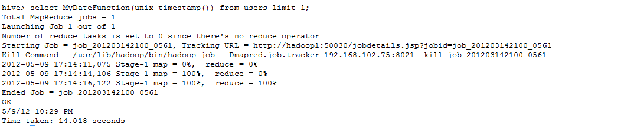
User-defined function (UDF)
The TEMPORARY keyword highlights the fact that UDFs are only defined for the duration of the Hive session (they are not persisted in the metastore). This means you need to add the JAR file, and define the function at the beginning of each script or session.
Now you can start using it.

Slide 54
User-defined Aggregate function (UDAF)
A UDAF works on multiple input rows and creates a single output row. Aggregate functions include such as COUNT and MAX.
New UDAF classes need to inherit from org.apache.hadoop.hive.ql.exec.UDAF class.
It contains one or more nested static classes implementing org.apache.hadoop.hive.ql.exec.UDAFEvaluator.

Slide 55
User-defined Aggregate function (UDAF)
An evaluator must implement five methods.
init () method, which reset the status of the aggregation function.
iterate()
The iterate() method is called every time there is a new value to be aggregated. The evaluator should update its internal state with the result of performing the aggregation. The arguments that iterate() takes correspond to those in the Hive function from which it was called.
terminatePartial()
The terminatePartial() method is called when Hive wants a result for the partial aggregation. The method must return an object that encapsulates the state of the aggregation.

Slide 56
User-defined Aggregate function (UDAF)
merge()
The merge() method is called when Hive decides to combine one partial aggregation with another. The method takes a single object whose type must correspond to the return type of the terminatePartial() method. The method should implement the logic to combine the evaluator’s state with the state of the partial aggregation.

Slide 57
User-defined Aggregate function (UDAF)
terminate()
The terminate() method is called when the final result of the aggregation is needed.

Slide 58
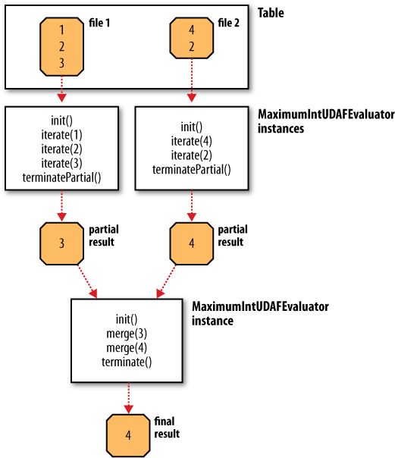
DATA FLOW WITH PARTIAL RESULTS FOR A UDAF

Slide 59
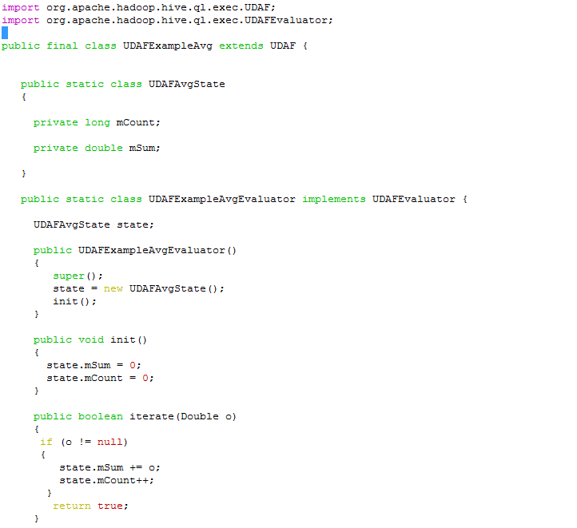
User-defined Aggregate function (UDAF) example

Slide 60
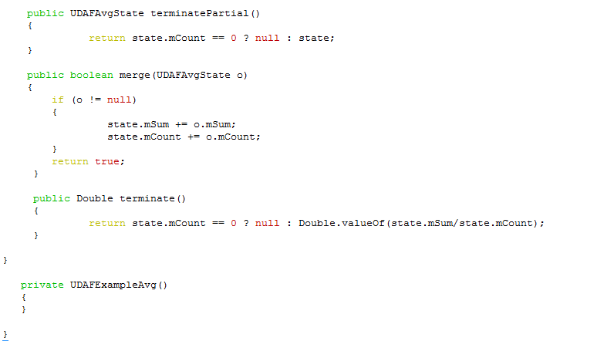
User-defined Aggregate function (UDAF) Example

Slide 61

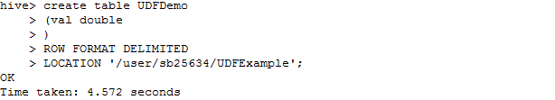
Creating Sample Table
Before using UDAF, let’s create a table and load it with some data to test UDAFs.
Create a file which will contain numbers of type double.
Start hive CLI using hive command.
Create table using following Hive DDL query.

Slide 62

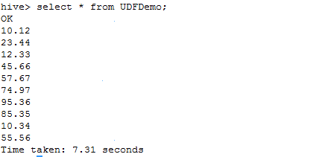
Loading data in sample table
Load data in table using load data command as shown below.

Slide 63

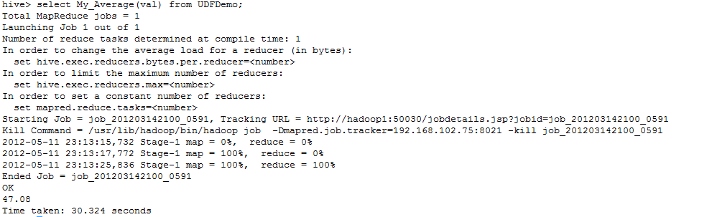
User-defined Aggregate function (UDAF)
As the java class for UDAF has nested classes, make sure you add all these classes
in jar file.

Slide 64
User-defined Table-Generating function (UDTF)
New UDTF classes need to extend from org.apache.hadoop.hive.ql.udf.generic.GenericUDTF class. (There is no plain UDTF class.)
We need to implement three methods: initialize, process, and close. To emit output, we call the forward method

Slide 65
User-defined Table-Generating function (UDTF)
The initialize method:
This method will be called exactly once per instance. In addition to performing any custom initialization logic you may need, it is responsible for verifying the input types and specifying the output types.
Hive uses a system of ObjectInspectors to both describe types and to convert Objects into more specific types. For our tokenize, we want a single String as input, so we’ll check that the input ObjectInspector[] array contains a single PrimitiveObjectInspector of the STRING category. If anything is wrong, we throw a UDFArgumentException with a suitable error message

Slide 66
User-defined Table-Generating function (UDTF)
The process method:
This method is where the heavy lifting occurs. This method gets called for each row of the input.
The close method:
This method allows us to do any post-processing cleanup

Slide 67
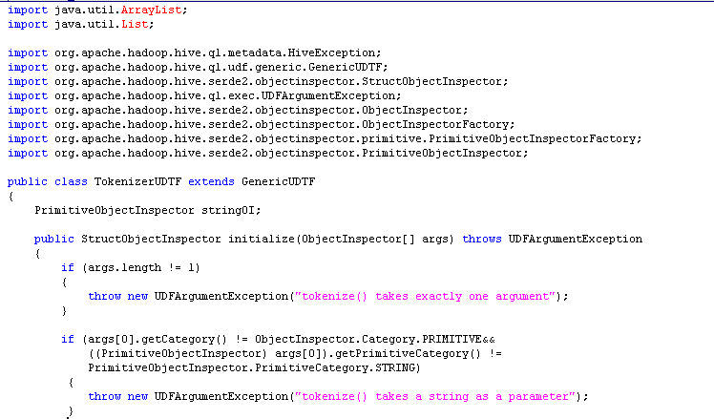
UDTF

Slide 68
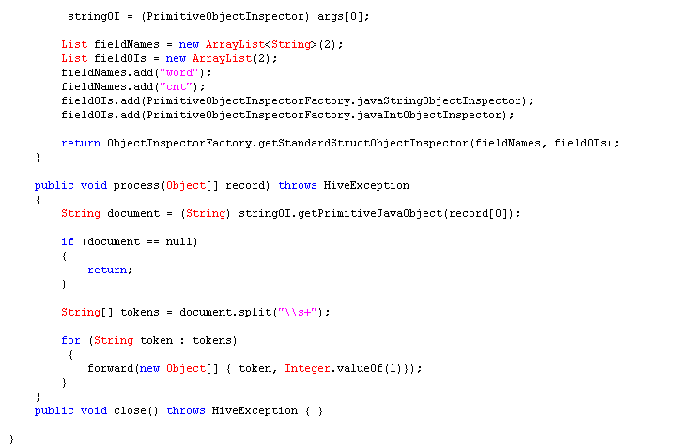
UDTF

Slide 69
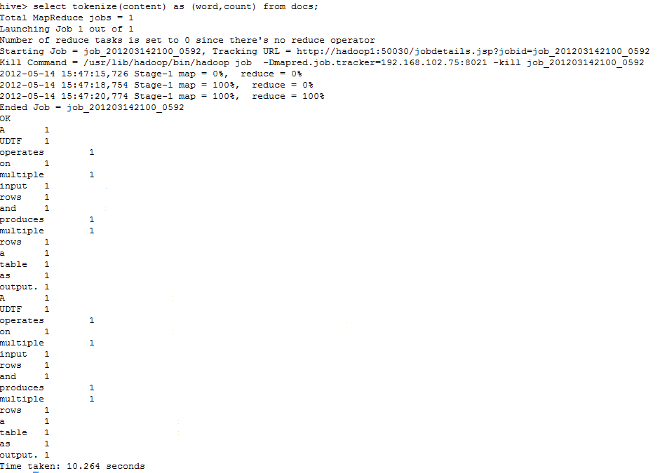
User-defined Table-Generating function (UDTF)

Slide 70
Project Status
Open source, Apache 2.0 license
Official subproject of Apache Hadoop
Several committers
Current version is 0.5.0

Slide 71
Related work
Parallel databases: Gamma, Bubba, Volcano
Google: Sawzall
Yahoo: Pig
IBM Research: JAQL
Microsoft: DryadLINQ, SCOPE
Greenplum: YAML MapReduce
Aster Data: In-database MapReduce
Business.com: CloudBase

Slide 72
Thank You

